Slide 1
Cricket Scoring APP
By Rijo Thottathil

Slide 2
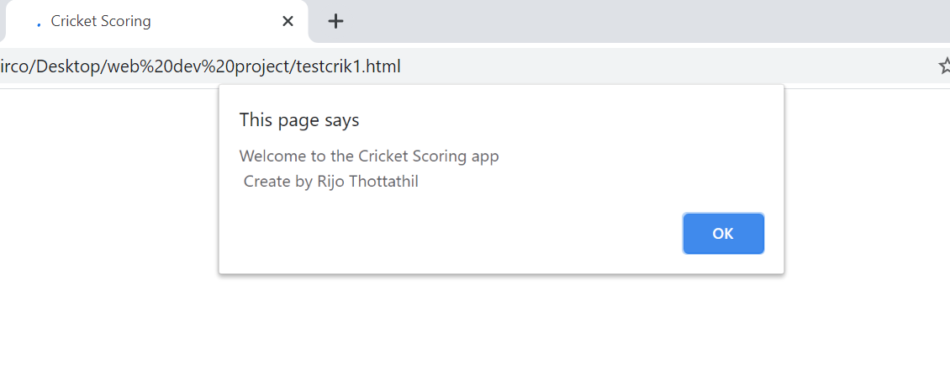
Welcome page

Slide 3

1st page: Enter the match details
Select no. of overs, Enter striker’s name, Enter non striker’s name, Next “Click “

Slide 4
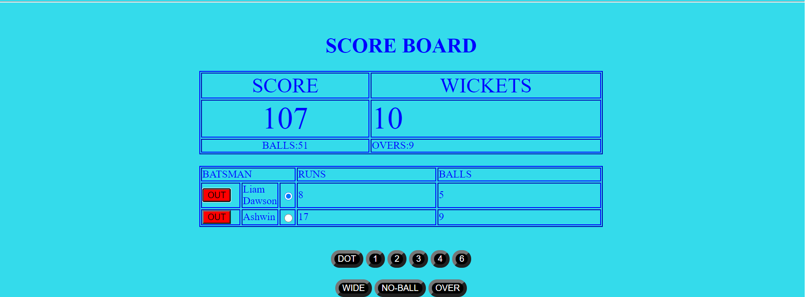
2nd page: Scoreboard
Score, wickets, no. of balls, no. of overs, Batsman’s Score, balls faced.
Out no.1, Out no.2- Click “Out” then a popup screen appears for the next batsman.
Dot, 1, 2, 3, 4, 6
Click dot then total no of balls will added and batsman faced balls will be added.
Click 1 to add one run and strike changes
Click 2 to add two runs
Click 3 to add three runs and striker changes
Click 4 and 6 when batsman scores to add to the total
Click Wide or No ball to add one run each.
When 6 balls bowling completed Click “Over "for next bowling over.

Slide 5

3rd page: Team Score Details
On the 3rd page Team Score details will be each players total no. score and total no. of balls faced will be recorded in the table.

